Slide 1
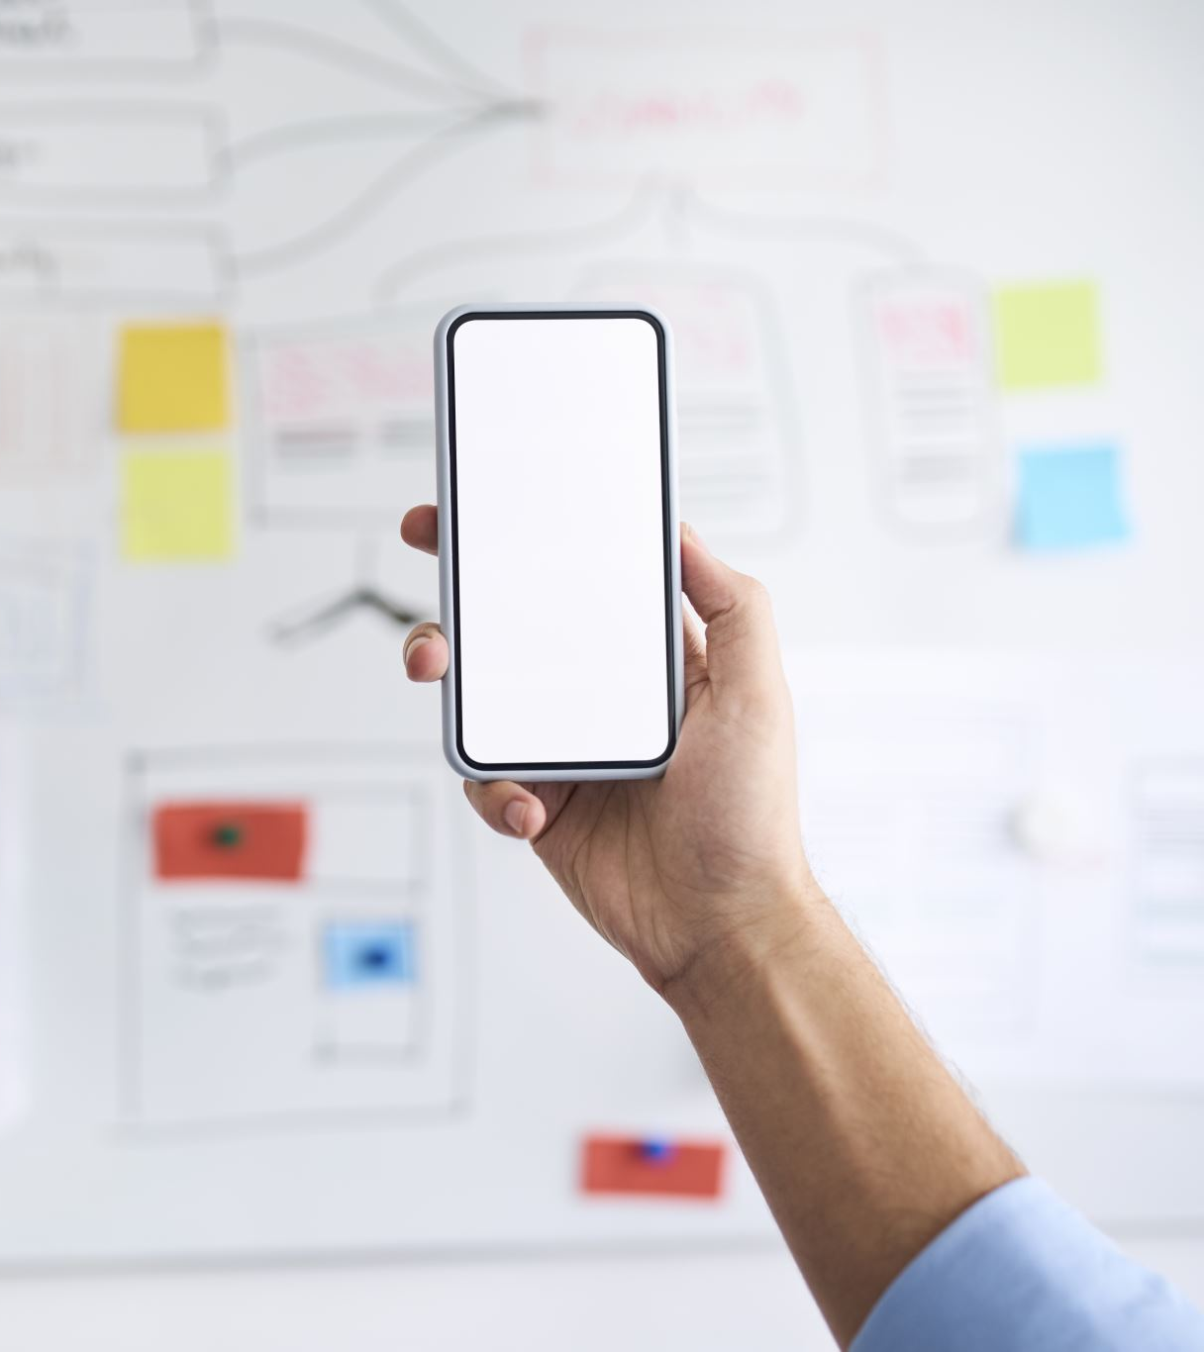
How to create a passkey for your Google account (and why you should)

Slide 3
Password less authentication is far more secure than using a traditional username and password. Essentially, password less authentication uses an encrypted key on a device -- your phone, for example -- to log you into an account. By using this method, it is far less likely that your accounts will be hacked by malicious users. On top of that, you won't have to bother typing lengthy passwords to log into your accounts. Instead, you simply OK the login attempt on your phone, and -- voilà! -- you're in.

Slide 4
How to create a new passkey for Google

Slide 5
What you'll need: To make this work, you'll only need a valid Google account and a web browser (I would recommend using Chrome). Do note that the device you use must be either a mobile device or a laptop/desktop with biometrics (such as a fingerprint scanner).

Slide 6
1. Log into your Google account
The first thing to do is to open your web browser and log into your Google account. If you've already done that, you're good to go; otherwise, you can open Gmail, Drive, Google Calendar (or any of the Google services) and log in.

Slide 7
2. Open the Passkeys manager
Next, head over to myaccount.google.com/signinoptions/passkeys. When the page loads, you'll be prompted for your account password once again.

Slide 8
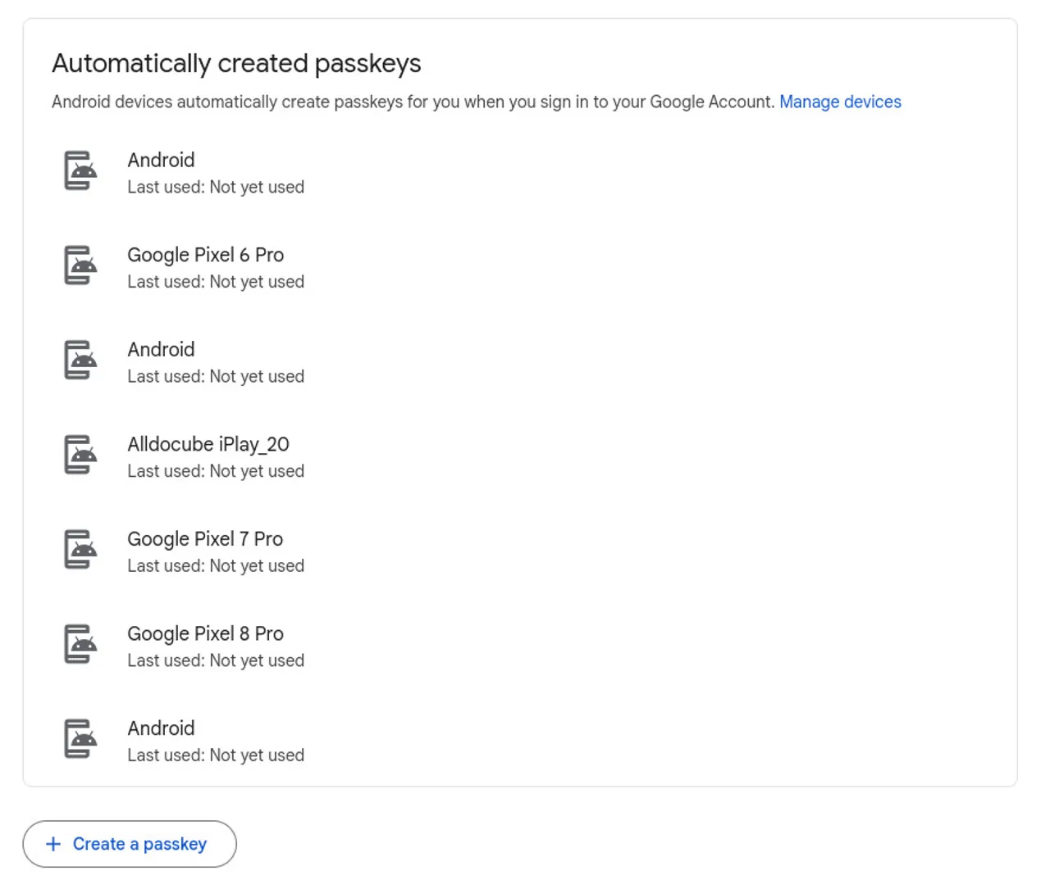
3. Create a new Passkey
On the resulting page, click Create a Passkey. You'll, once again, be prompted for your Google account password.
If you've already created passkeys on your mobile devices, they'll be listed here.

Slide 9
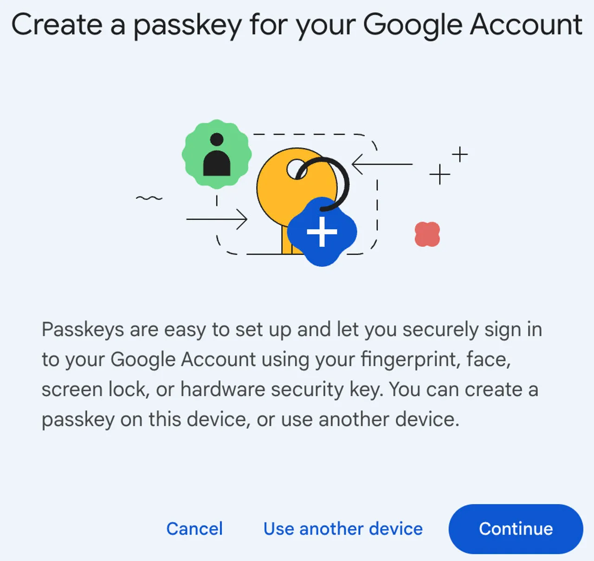
4. Continue with the Passkey creation
In the resulting pop-up, click Continue.

Slide 10
You will be prompted to allow Chrome to access and use your passkeys. When prompted, click Allow. If you're using MacOS, you'll need to make sure to turn on iCloud Keychain (if it's not already enabled). Once you've done that, you'll be prompted for your fingerprint and then the passkey is done and ready to use.
Passkeys are the way of the future for Google account verification. I would highly recommend you set yours up as soon as possible. It's simple to do and highly secure.

Slide 11
What do I need to use passkeys?
Here are the system requirements for passkeys:
A system running at least Windows 10, MacOS Ventura, or ChromeOS 109
A smartphone or tablet running at least iOS 16, iPadOS 16, or Android 9
Optional: a hardware security key with FIDO2 protocol support
The computer or mobile device you are using will also need a supported browser, such as:
Chrome 109 or greater
Safari 16 or greater
Edge 109 or greater

Slide 12
